Slide 1

EMAIL/SMS SPAM CLASSIFICATION
Ibrahim Abdul Shukoor
Internship – 30

Slide 2

1.
INDEX
INTRODUCTION
PREPROCESSING
VISUALIZATIONS
CLASSIFICATION & PERFORMANCE
CONCLUSIONS

Slide 3
2.
INTRODUCTIONS
Spam classification is important because it helps to filter out unwanted and potentially harmful messages from an individual's inbox or messaging app. It can improve the user experience by making it easier to sort through messages, protect against security threats by identifying and blocking malicious messages, protect privacy by preventing sensitive information from being shared with unauthorized parties, and improve email delivery rates by accurately identifying and filtering out spam messages.

Slide 4
3.
PREPROCESSING
Three “Unnamed” columns were dropped from the dataset for containing 100% null values.
Emails, Websites, Currencies, Phone numbers were replaced with simple words.
Removed alphanumeric characters and stop words.
Cleaned additional things such as trailing, leading white spaces.
Tokenized and lemmatized the sentences.
Performed Sentiment analysis (i.e; added Polarity and Subjectivity columns)

Slide 5
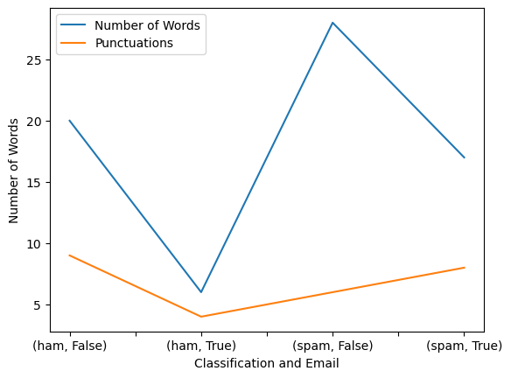
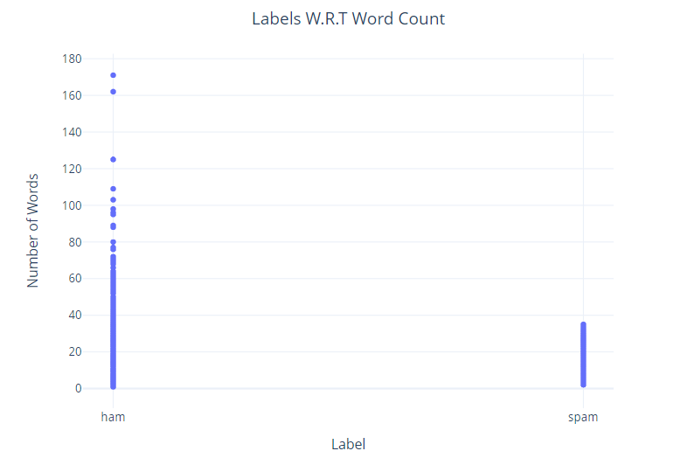
4.
VISUALIZATIONS
Spam emails and messages tend to have more words than legitimate ones because spam emails are often sent only once, while legitimate emails and messages may be part of ongoing conversations between two people. Since spam emails are typically sent to many recipients, they often include more words in order to try and capture the recipient's attention and convince them to take some sort of action (e.g., click on a link, purchase a product).

Slide 6
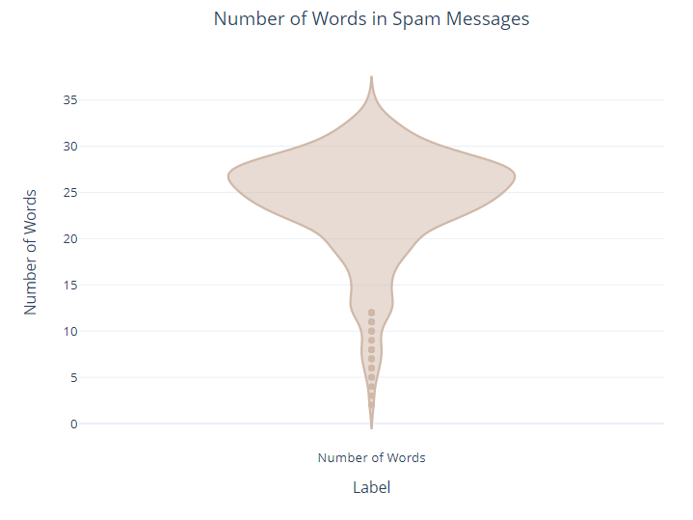
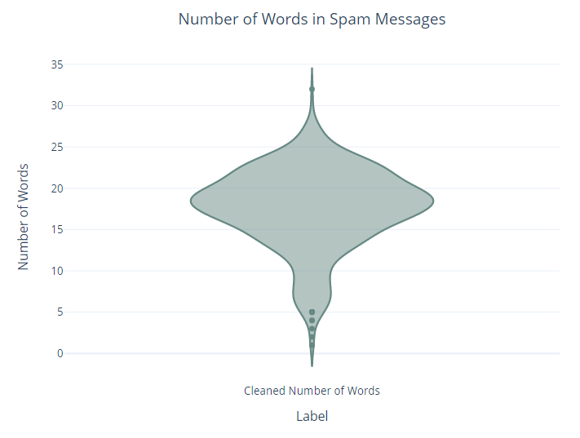
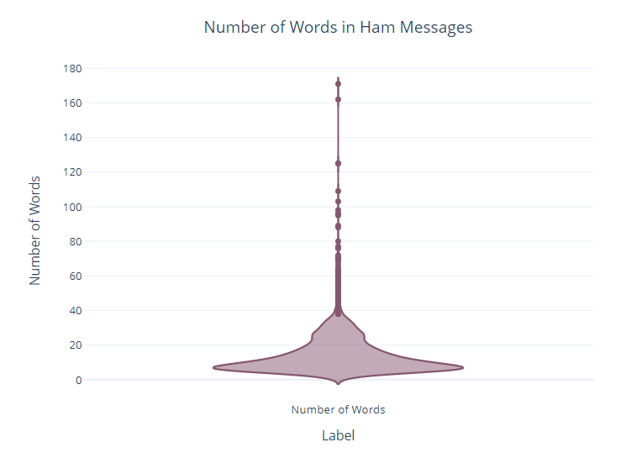
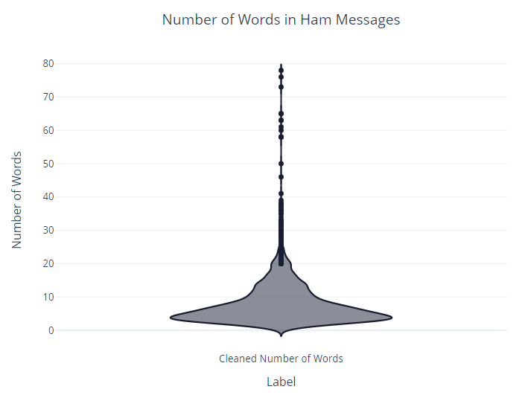
5.

Slide 7
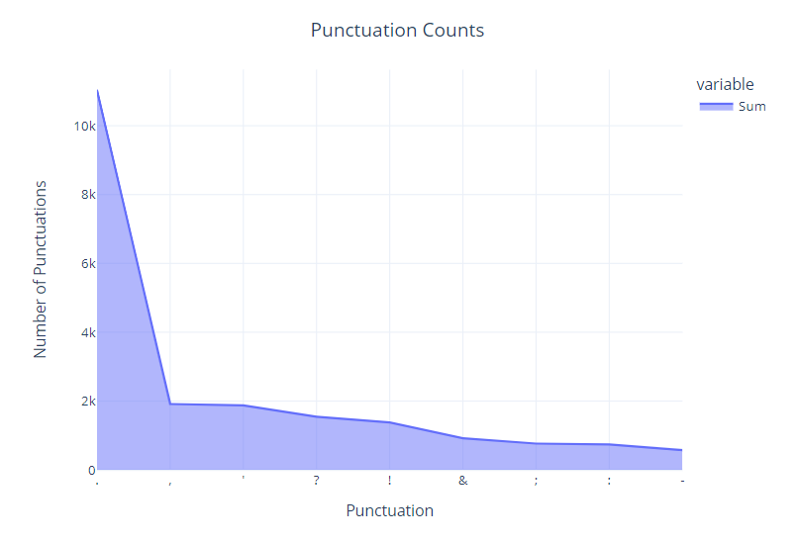
6.
VISUALIZATIONS
In spam messages, it is common to see a higher number of punctuation symbols such as @ and currency symbols like $ or £. This is because spam messages often contain emails or mention cash prizes as a way to entice people to fall for a scam.

Slide 8
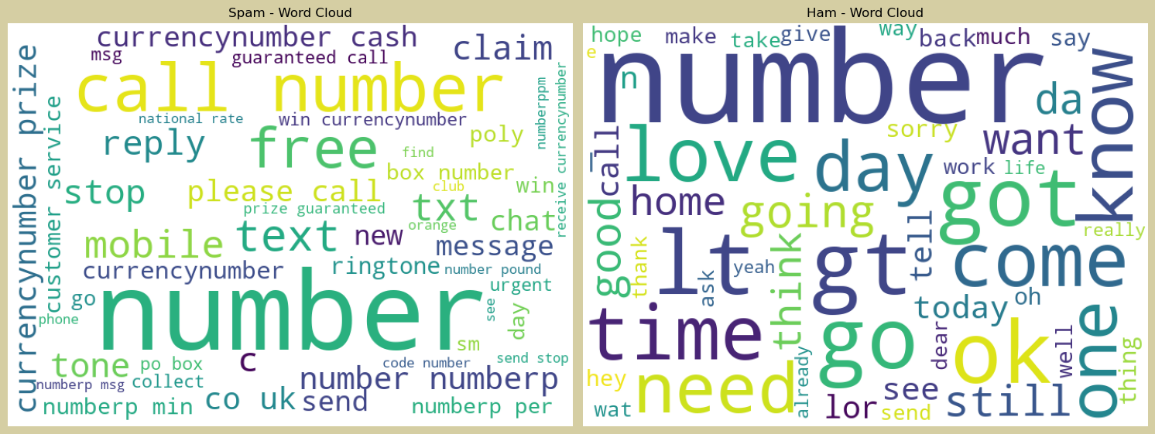
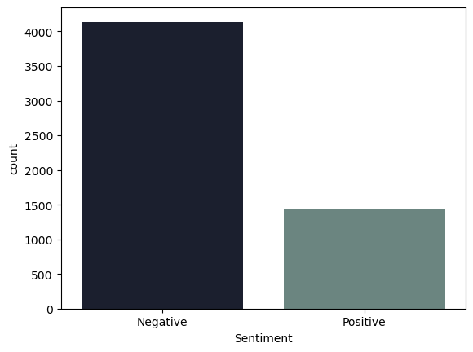
VISUALIZATIONS
7.
During sentiment analysis, it was found that most spam messages have a positive sentiment. This means that spam messages tend to use positive language and emotion-evoking words like (“win”, “guaranteed prizes”, “call urgently”) to convince recipients to take some sort of action.

Slide 9
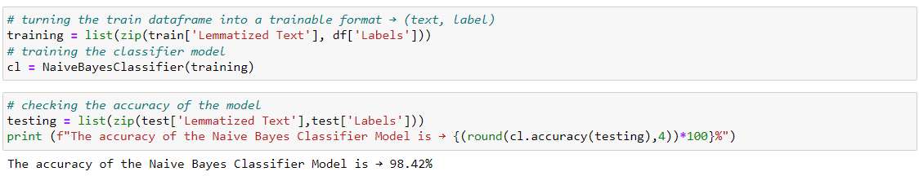
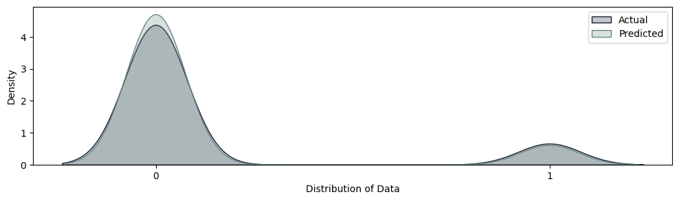
CLASSIFICATION & PERFORMANCE
8.

Slide 10
9.
CONCLUSION
Built a Naive Bayes Classifier Model using TextBlob’s library that classified messages as spam or ham with 98% accuracy.
As evident from the value counts of the testing data, to add to that a dataframe was created without the Labels column to see if the model was able to predict spam and ham. It only mis-classified 22 messages from the total of 1393 messages (from the test data); which can be considered successful!

